Slide 1

VotingDAO
Ibolya Lukacsovics, Tunç Polat, Nicole Grandi, Sardor Butunboev
03/12/2021 - Smart Contracts and Decentralized Blockchain Applications
HS 2021

Slide 2
VotingDAO
Table Of Contents
01
Introduction
02
Demonstration
03
Coding Section
What is the idea and why on the earth?
Let’s do absolutes, not If’s, Buts, and Maybes
How is it cried coded?
04
Limitations
05
Theoretical Solutions
06
Q&A
The road to success is paved with limitations
What could we do if we were paid enough?
We love it when questions are sent to our pager

Slide 3

Page 3
What is the idea and why on the earth?
Introduction
01
02
Importance of Voting
Technologies
Voting process is one of the main cornerstones
One of the reprentative examples is smart contract
03
Voting DAO
Our objective is to deploy a smart contract which guarantees a fair voting process
HS 2021

Slide 4
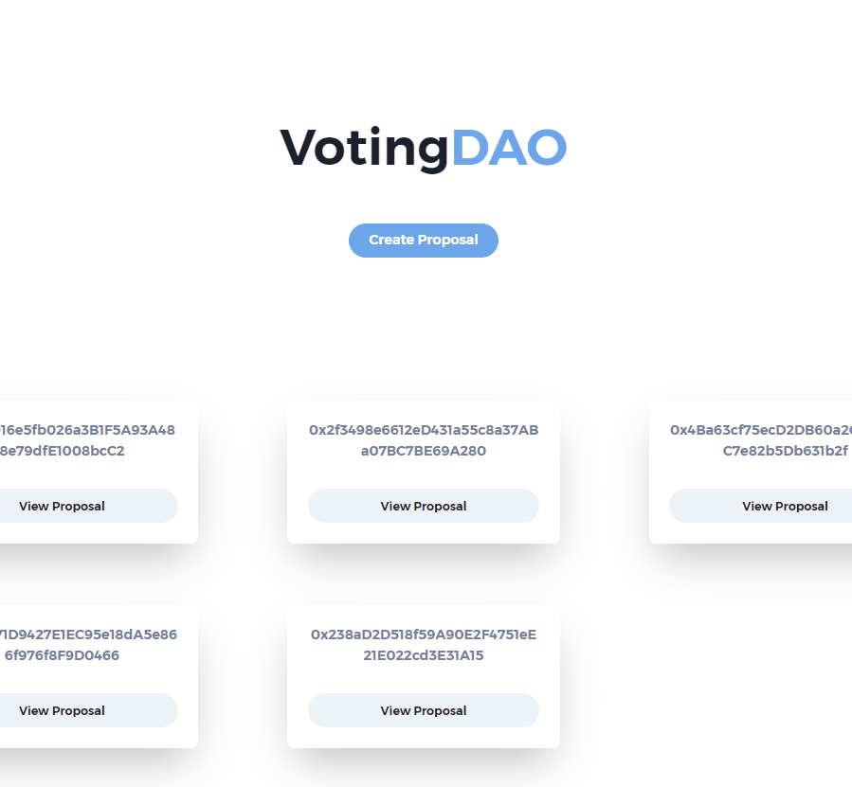

Page 4
Let’s do absolutes, not If’s, Buts, and Maybes
Demonstration DApp
Imagine a startup in a hiring process with four people.
HS 2021

Slide 5
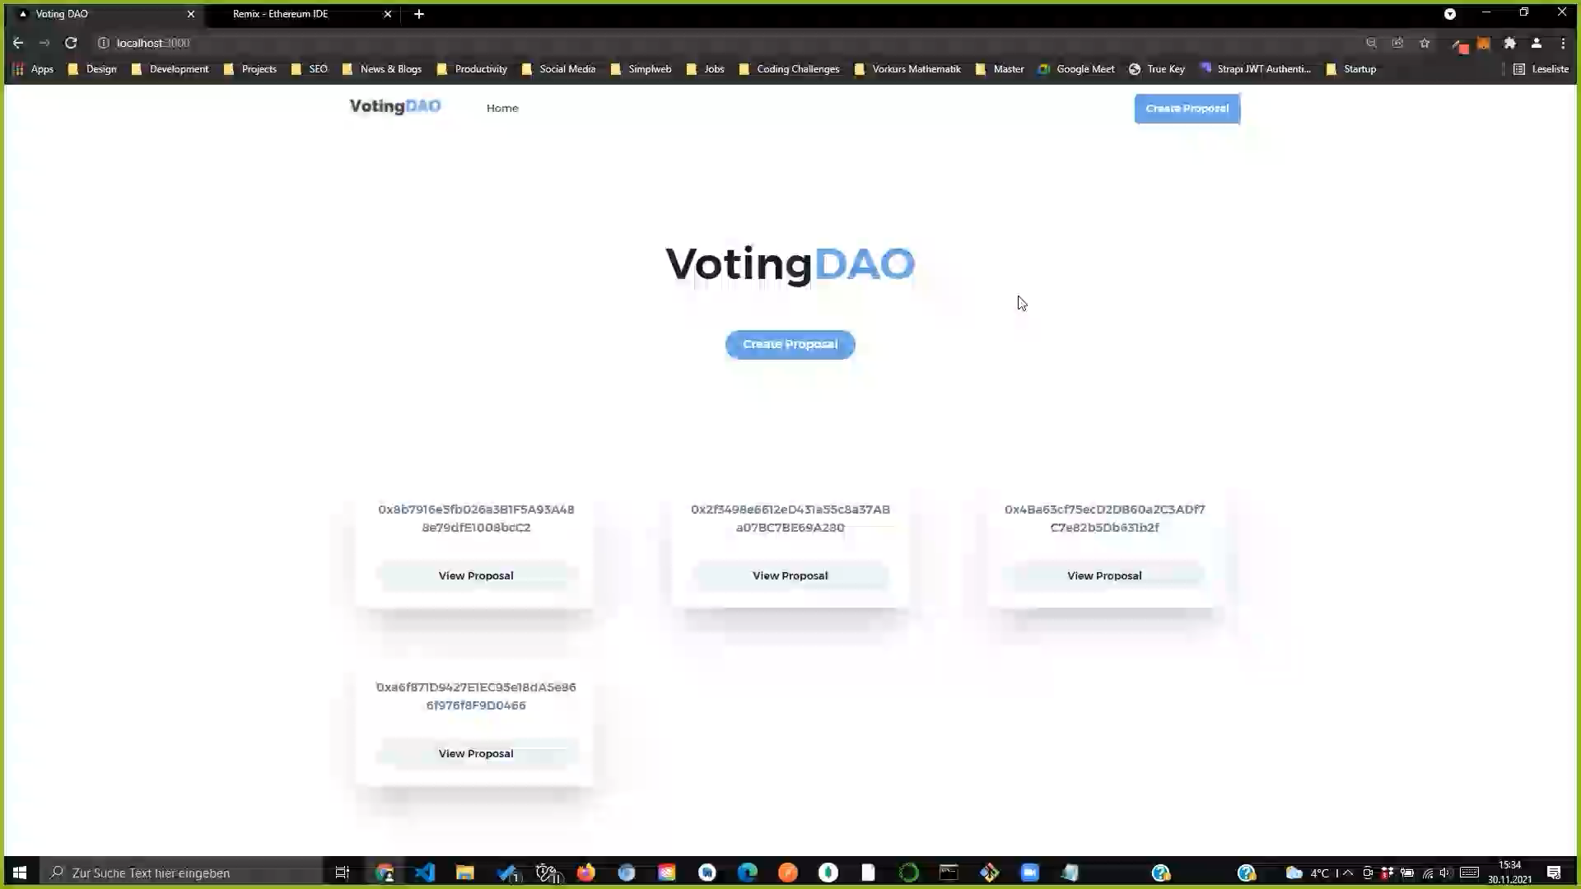

Slide 6
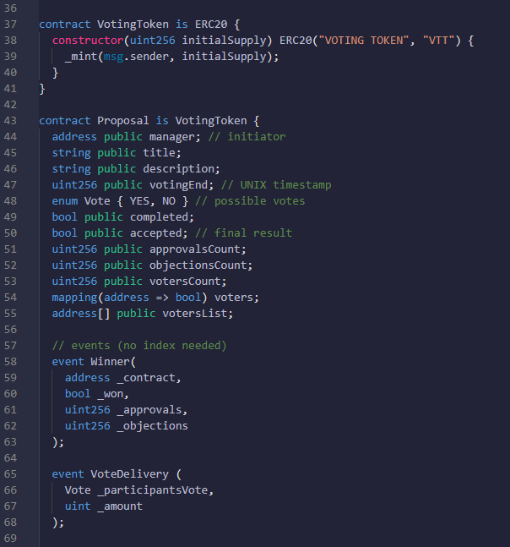
Inheritance & ERC20
Variables & Events
Notes:
Inheritance & ERC20:
https://docs.soliditylang.org/en/v0.8.10/contracts.html#arguments-for-base-constructors
«Arguments have to be given either in the inheritance list or in modifier-style in the derived constructor.»

Slide 7
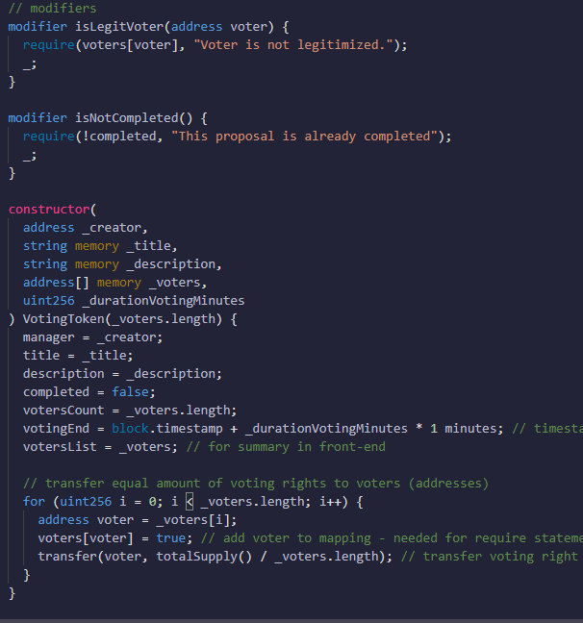
Modifiers
Constructor
Transfering Votes
Notes:
Constructor:
https://docs.soliditylang.org/en/v0.8.10/contracts.html#arguments-for-base-constructors
«Arguments have to be given either in the inheritance list or in modifier-style in the derived constructor.»

Slide 8
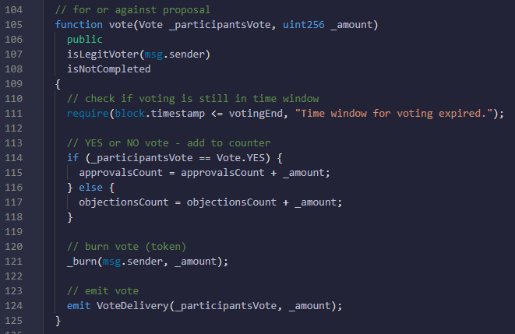
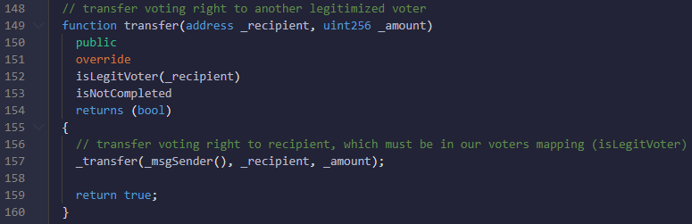
Vote
Proxy Voting

Slide 9
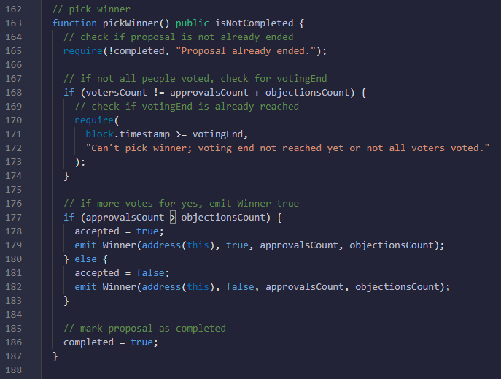
Pick Winner Proposal

Slide 10
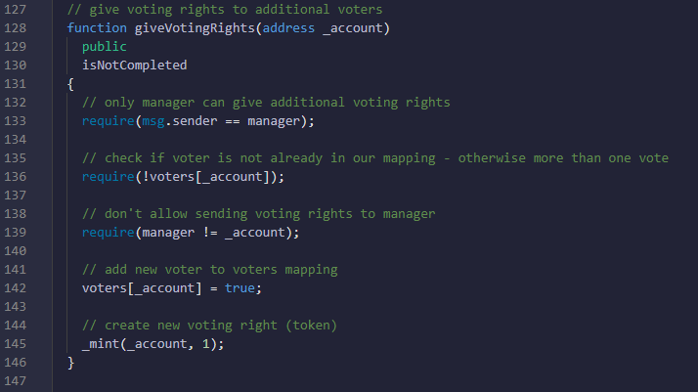
Mint Voting Rights

Slide 11
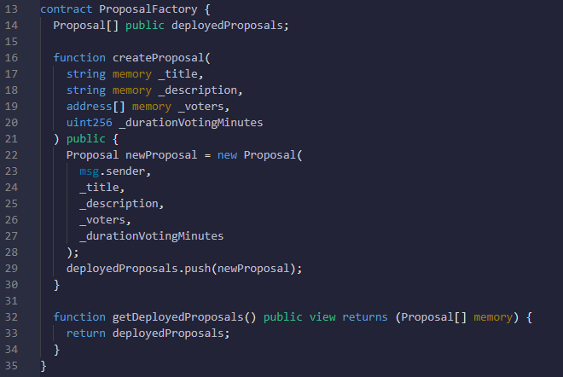
Contract Architecture

Slide 12
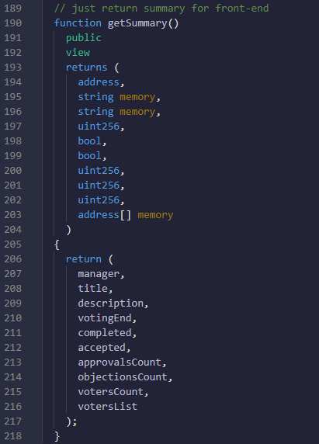
… just for FE

Slide 13
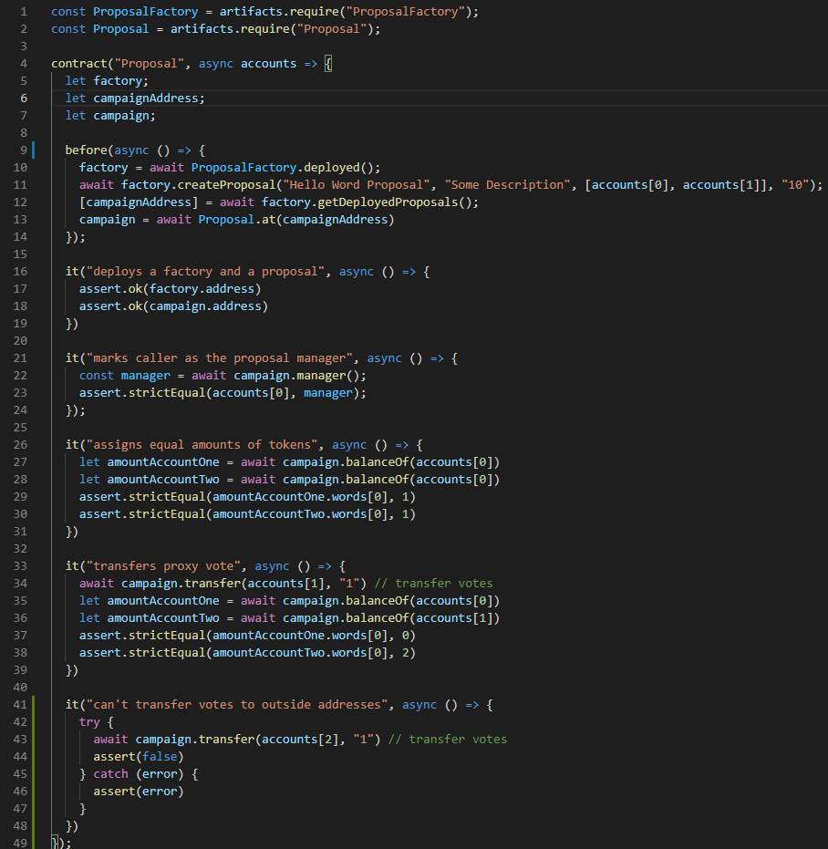
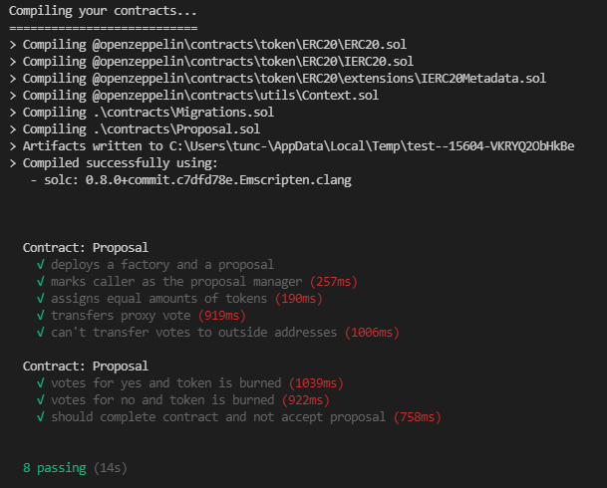
UNIT Testing

Slide 14

https://github.com/tuncpolat/voting-dao-dapp

Slide 15
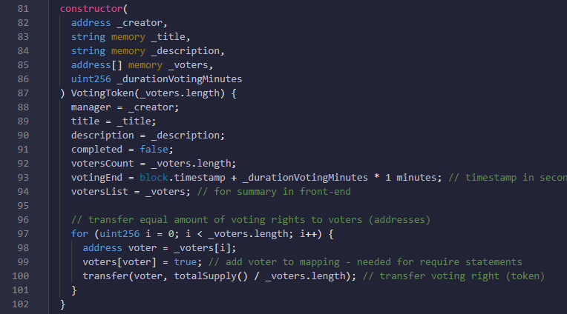
VotingDAO
Page 15
The road to success is paved with
Limitations
93 block.timestamp
Not production ready, because block.timestamp can be manipulated by the miner.
97 Linear Algorithm – O(n)
With increasing n, need of computational ressources increase linearly and are no longer negligible with large n (list of voters). In ETH-world more computational ressources mean higher fees. We need this for-loop, because Mappings are not allowed as params in Solidity… and we need Mappings to make search queries in the contract.

Slide 16
VotingDAO
Page 16
Possible
Theoretical Solution From O(n) to O(log(n))
01
InterPlanetary File System (IPFS)
Before initializing the smart contract, manager stores the voters list in IPFS and receives (calculates) the root hash of the merkle tree.
Save Root Hash in Smart Contract
Instead of saving all of the voters in the smart contract, the idea is to save just the root hash of the merkle tree.

Slide 17
VotingDAO
02
Page 17
Before Voting
Voter takes all elements that he/she needs from the merkle tree from IPFS to verify that he/she is an legit voter later on.
Pass as Params in Smart Contract Function
Calls the function to vote with all the parameters.
03
Smart Contract Verifies Only Hash
Instead of verifying all the voters in a list or mapping, smart contract just needs to verify the hash. With this method we can skip the for loop in the constructor function.

Slide 18
VotingDAO
Thank You
HS 2021

Slide 19
References
Images:
https://unsplash.com/photos/v0OWc_skg0g
Icons:
Github: https://www.flaticon.com/de/
Slide Template:
https://elements.envato.com/de/cryptolink-cryptocurrency-powerpoint-RGXH3N7

